Slide 1



AIR QUALITY
Prediction System: 24-Hour Forecasting for Qatar Using AI (Multivariate LSTM)
GROUP 8

Slide 2
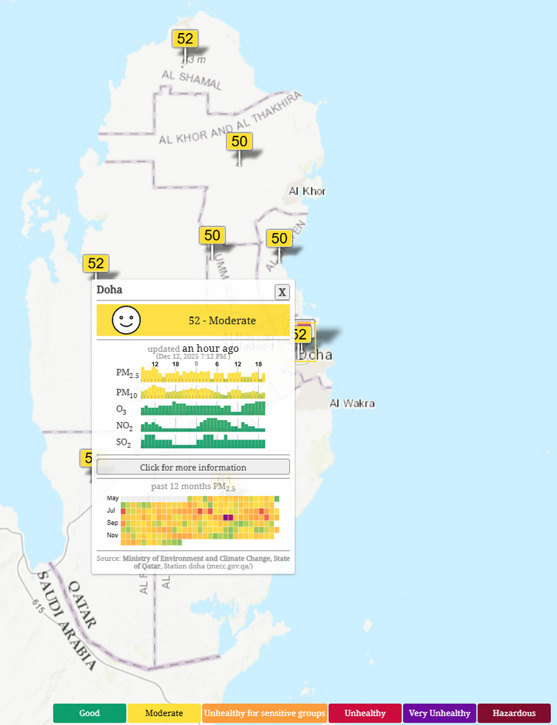

The Air Quality Problem in Qatar
Air Quality Challenges
Qatar faces significant air quality challenges due to high levels of PM2.5 and PM10 pollution.
Qatar experiences frequent air pollution from dust storms, traffic, and industry
Current systems report pollution after it happens, not before
Sensor Limitations
Current air quality sensors are limited, resulting in gaps in data collection and inadequate forecasting capabilities.Ground sensors cover only small areas.
NASA Earth Observatory. (2004, February 26). Massive Sandstorm in Qatar. NASA Science. https://science.nasa.gov/earth/earth-observatory/massive-sandstorm-in-qatar-4256/
The. (2024). Air Pollution in Qatar: Real-time Air Quality Index Visual Map. Aqicn.org. https://aqicn.org/map/qatar/

Slide 3





Project Objective
Build an AI system that predicts PM2.5 air quality 24 hours in advance across Qatar.
Combine ground sensors, satellite imagery, and weather data
Learn pollution behavior over time using deep learning
Enable early warnings for health and policy planning
DATA SOURCES
AI MODEL
24-HOUR FORECAST
PEOPLE & INSTITUTIONS

Slide 4






Data Sources
Multi-Source Data Collection
1
2
3
Ground Sensors
Satellite Data
Weather Data
Temperature
Humidity
Wind speed & direction
Rainfall
PM2.5, PM10
NO₂, SO₂, CO
Real street-level measurements
Sentinel-5P
Aerosol Optical Depth (AOD)
NO₂ column density
Detects incoming dust & haze

Slide 5
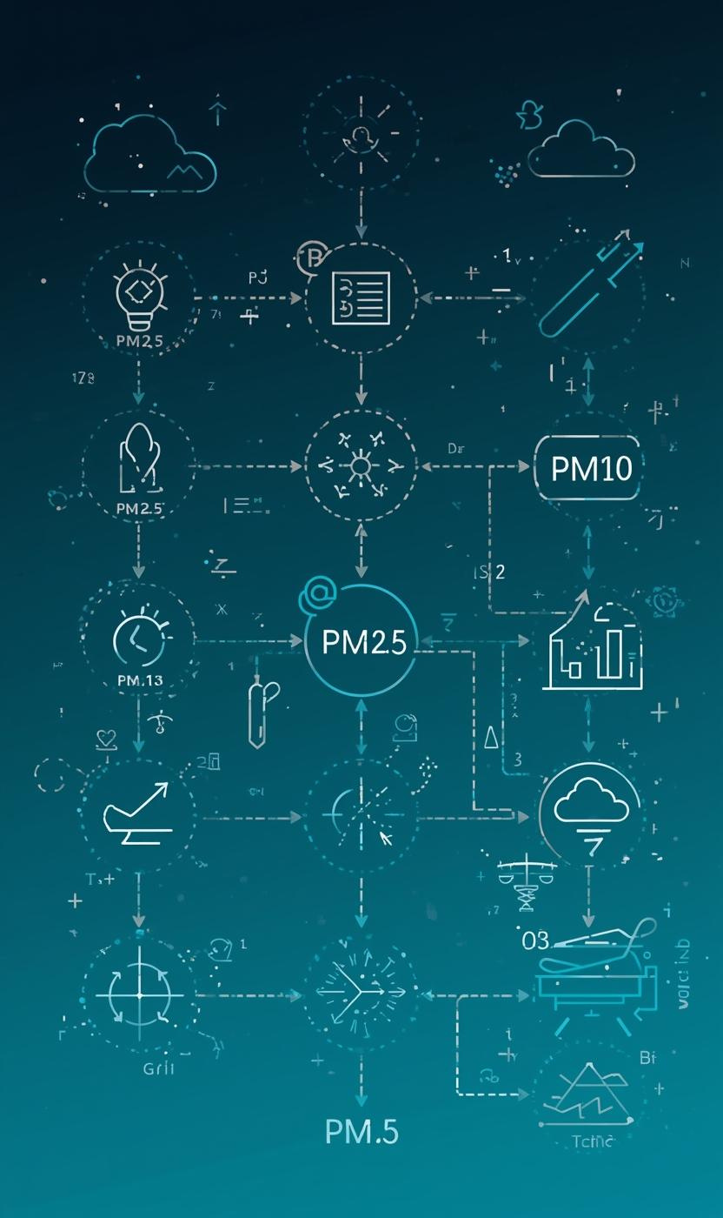
Dataset & Feature Engineering
The dataset comprises hourly air quality data from 2023 to 2025 across six regions in Qatar. This extensive collection focuses on key pollutants, specifically PM2.5 and PM10 levels, which are critical for assessing air quality. Additionally, the dataset incorporates meteorological drivers such as temperature, humidity, and wind speed, allowing for a comprehensive analysis of factors influencing air quality. The integration of diverse data sources enhances the model's predictive capabilities.
Feature engineering plays a crucial role in preparing the data for the AI model. Key pollution sources are identified, enabling targeted interventions for better air quality management. Transformations such as hour sine/cosine and wind direction encoding are performed to capture seasonal patterns and improve model performance. These engineered features facilitate a deeper understanding of the environmental influences on air quality, ultimately contributing to the accuracy of the 24-hour forecasting system.
Hourly data from 2023–2025
Covers 6 regions in Qatar (Doha, Wakrah, Al Khor, etc.)
Features grouped into:
Target: PM2.5 (main prediction)
Weather drivers: wind, humidity, temperature, rain
Pollution sources: NO₂, SO₂, CO, dust
Satellite indicators: AOD

Slide 6
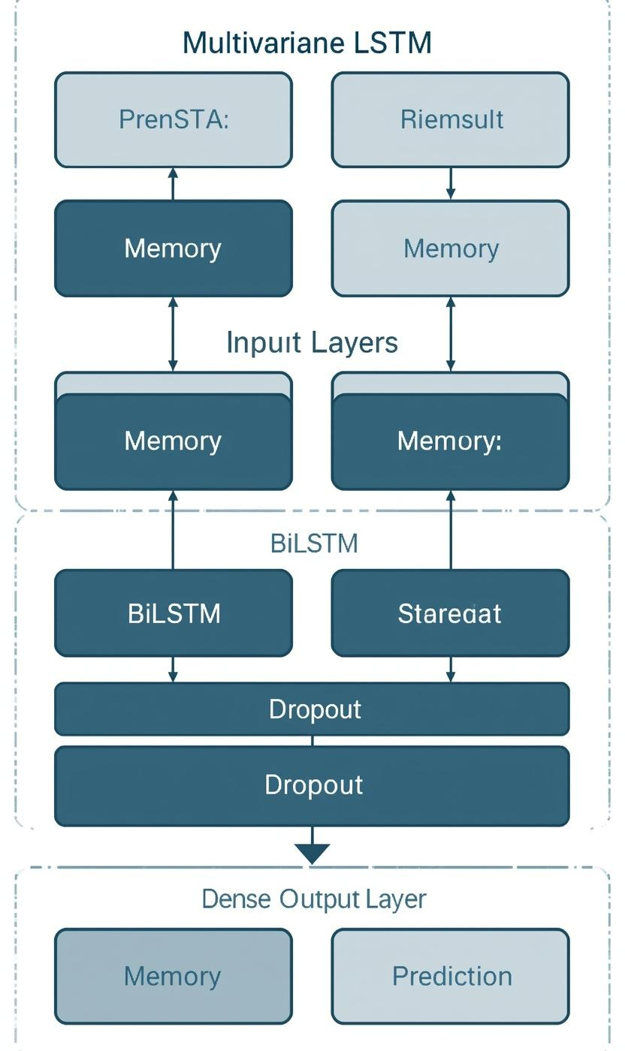
AI Technique Overview
LSTM = neural network for time-series data
Remembers patterns across past 48 hours
Handles non-linear effects (dust storms, humidity trapping)
Model structure (text):
Input → LSTM (128) → Dropout
→ LSTM (64) → Dropout
→ Dense (32) → Output (PM2.5)
The Multivariate LSTM model is designed to capture temporal dependencies in air quality data by remembering the last 48 hours. This approach allows the model to learn from historical trends, improving prediction accuracy for pollutants like PM2.5 and PM10. By integrating multiple data sources, the model effectively synthesizes environmental factors, ensuring a comprehensive understanding of air quality dynamics across different regions in Qatar.
Input dimensions for the model are carefully structured to include essential features such as meteorological conditions and pollution sources. The architecture utilizes bidirectional layers, enhancing learning by processing data in both forward and backward time sequences. This design is pivotal for maintaining context within the model, ensuring that predictions reflect not only current conditions but also anticipated changes based on previous observations.

Slide 7
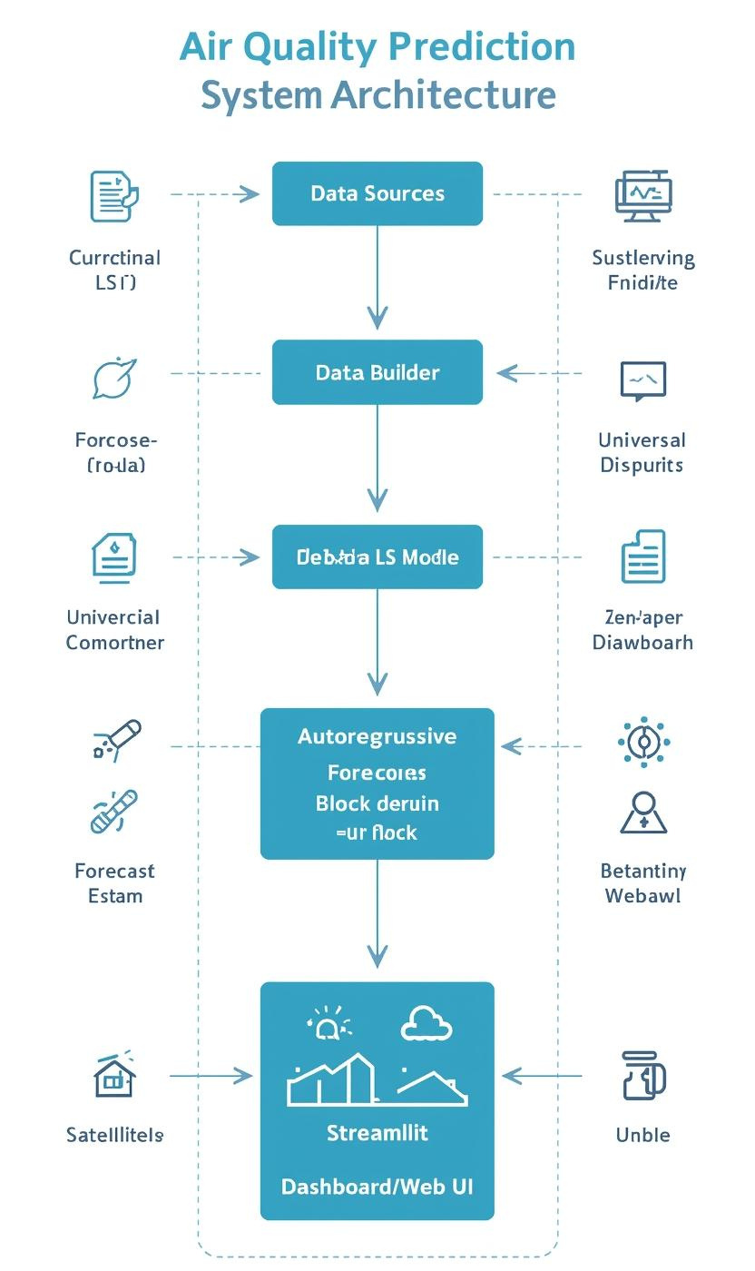
System Architecture
The system architecture illustrates the comprehensive flow from data acquisition to actionable forecasts. It begins with data sources from ground sensors, satellites, and weather APIs that provide real-time atmospheric information. The pipeline ensures data integrity through cleaning and normalization, preparing it for further analysis. This framework plays a crucial role in accurately predicting air quality levels, enabling timely responses to pollution challenges faced in Qatar.
Following data processing, the sequence builder organizes the information into manageable windows, feeding it into the Universal LSTM model. This model employs advanced algorithms to analyze historical patterns and generate predictions for the next 24 hours. The autoregressive forecast block enhances accuracy by continuously updating forecasts based on real-time inputs. Finally, the Streamlit dashboard presents these forecasts visually, making them accessible to users, including schools and environmental agencies.

Slide 8
Live Demo
Reliable Forecasting
Policy Support
This project enables accurate air quality predictions, essential for protecting public health in urban areas.
The insights provided can guide effective environmental policies, promoting proactive measures for vulnerable groups.

Slide 9
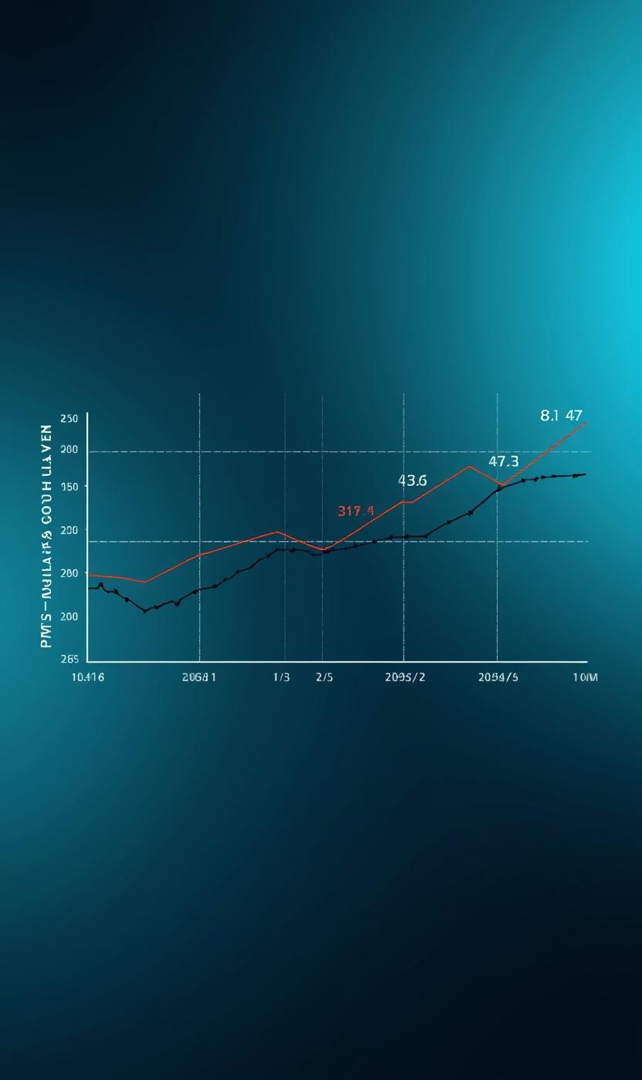
Forecast Visualization
The demonstration of the 48-hour actual vs. 24-hour forecast PM2.5 levels in Doha showcases the model's effectiveness. The black line represents the historical data, while the red dashed line indicates the forecast. This visual representation allows stakeholders to quickly assess air quality trends and anticipate changes. The clear delineation of actual versus predicted values highlights the model's precision and reliability in forecasting air quality.
Moreover, this visual aids in communicating crucial information to the public and decision-makers. By illustrating the forecast alongside real-time data, users can understand the expected air quality and take appropriate actions. The integration of visuals emphasizes the importance of timely forecasting in managing public health and environmental standards, ultimately supporting informed decisions in Qatar's air quality management strategies.

Slide 10
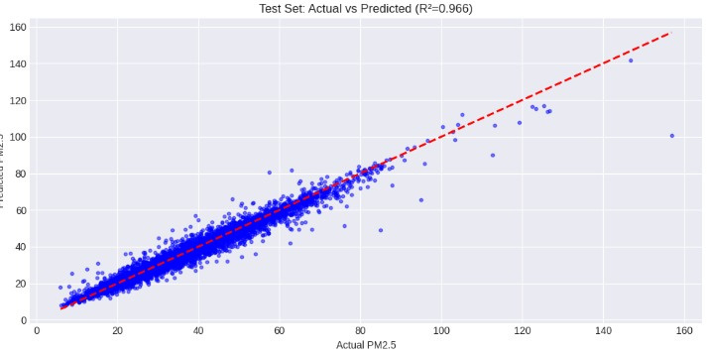
Key Results
The analysis of prediction errors revealed a clustering near zero, emphasizing the model's reliability. A scatter plot titled "Actual vs Predicted PM2.5" further illustrates this correlation, with most points falling along the diagonal reference line. Our findings confirm that the model effectively captures daily pollution cycles and the varying influences of meteorological factors, making it an invaluable tool for air quality management in Qatar.
The accuracy metrics for our test sets showcase the effectiveness of our AI model. With a Mean Absolute Error (MAE) of just 1.65 µg/m³ and a Root Mean Squared Error (RMSE) of 2.65 µg/m³, the model demonstrates a strong predictive capability. The R² value of 0.9217 indicates a high level of correlation between predicted and actual PM2.5 values, validating our approach towards accurate forecasting in Qatar's diverse environments.

Slide 11

Future Roadmap
Short Term Goals
Medium Term Goals
Long Term Goals
Policy Integration
Add more regions and sensors for better coverage.
Implement real-time streaming for improved forecasting accuracy.
Develop public dashboards for community access and awareness.
Collaborate with authorities for effective air quality management.

Slide 12
Conclusion:
AI + multi-source data enables reliable air quality forecasts:
System supports proactive health & policy decisions:
Scalable to national and regional use:
The resulting comprehensive air quality monitoring system supports proactive health and policy decisions, allowing officials to issue timely health advisories and implement targeted environmental regulations to protect citizens.
By utilizing Artificial Intelligence combined with diverse multi-source data streams (like satellite imagery, ground sensors, and traffic patterns), scientists can now generate highly reliable and accurate air quality forecasts.
The resulting comprehensive air quality monitoring system supports proactive health and policy decisions, allowing officials to issue timely health advisories and implement targeted environmental regulations to protect citizens.

Slide 13

Questions?

